Slide 1
CS 2600 Computer Networks I Dr. Sayeed Sajal Lecture 26 Bridges, LAN Switches and Spanning Tree

Slide 2
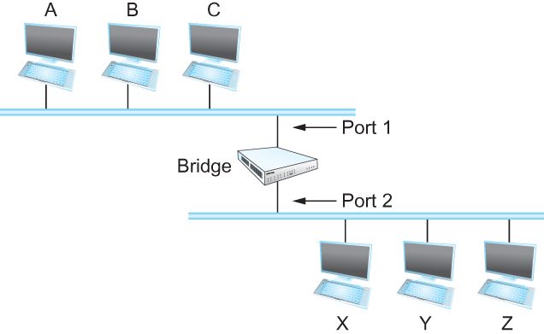
Figure 3.9 Illustration of a Learning Bridge*
LAN Segment A
Bridge
LAN Segment B
*Also called a MAC Layer Bridge

Slide 3
WiFi Distribution Network Showing Segments Bridged by Access Points
Segment B
Segment A
Segment C

Slide 4
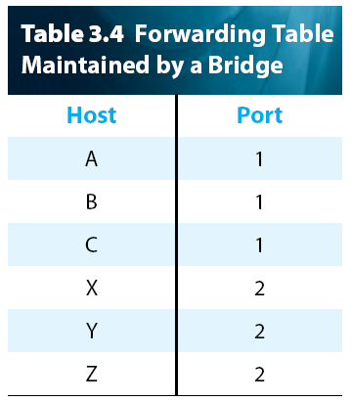
Example of Forwarding (Based on Figure 3.9)

Slide 5
Example of Filtering (Based on Figure 3.9)

Slide 6
Flowchart for Bridge, Switch and WiFi Access Point Learning

Slide 7
An Ethernet Switch

Slide 8
Ethernet Collision Domains
A collision domain is the set of Ethernet nodes that compete for the same link (and could therefore be involved in a collision with each other)
With coax and hub-based Ethernets, the entire network segment was a single collision domain
With Ethernet switches, each switch port is a separate collision domain, because the memory in the switch can hold a frame during contention until the outbound port becomes available (thus avoiding a collision between two frames competing for that outbound port)
Even so, a “collision” can occur if the switch runs out of memory and there is nowhere to store the next inbound frame. (This will be signaled to the adapter the same way as a true CSMA/CD collision.)
A switch collision can also occur if the twisted pair drop cable is configured as half duplex (HDX), and the switch sends a frame to the adapter at the same time that the adapter sends a frame to the switch

Slide 9
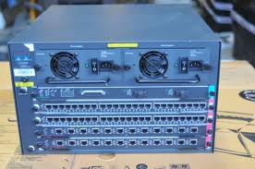
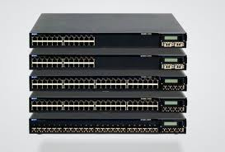
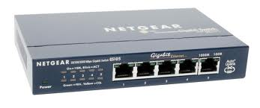
Typical Ethernet Switches
Cisco Catalyst 5500 switch (note dual power supplies)
Juniper EX4200 line of stackable Ethernet switches
Netgear GS105 consumer-grade switch*
*If you are in the Networking Emphasis, look for a used Netgear EN104TP Ethernet hub (~$50, useful for packet sniffing).

Slide 10
Enhancing Ethernet Reliability with Redundant Bridges

Slide 11
Switched Ethernet LAN With Mesh Topology

Slide 12
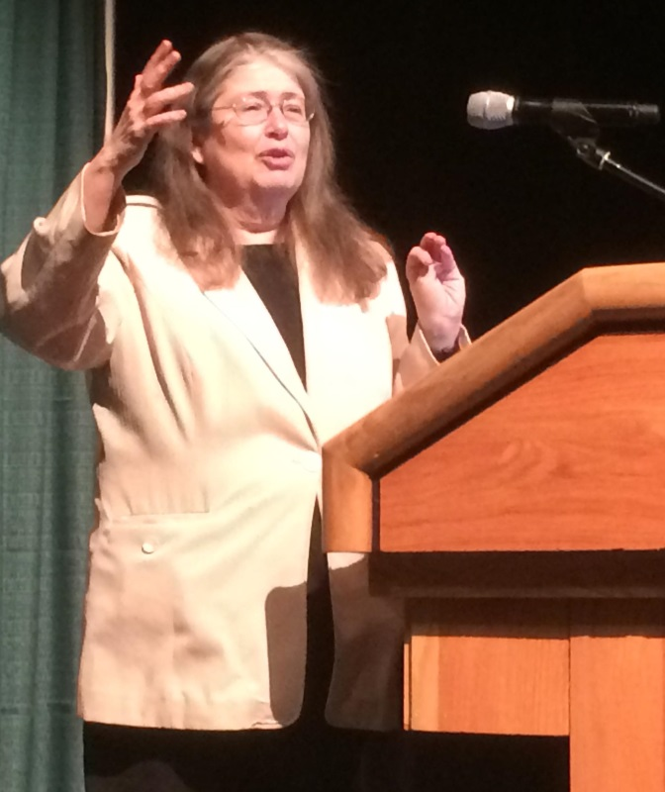
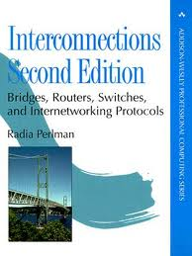
Dr. Radia Perlman – Routing Pioneer
Dr. Perlman developed the implementation of the Spanning Tree Protocol for LANs (IEEE 802.1d). She was named “Silicon Valley Inventor of the Year” in 2004, and twice named “One of the 20 Most Influential People in the Industry” by Data Communications Magazine. Some call her “the Mother of the Internet”. Her treatise on routing and switching algorithms, Interconnections (2nd Ed.), is a must read for any networking expert. She currently works for Dell EMC Corp.

Slide 13
Example of (a) a Cyclic Graph; (b) a Corresponding Spanning Tree (Adapted from Figure 3.11)
Before Spanning Tree
After Spanning Tree
root bridge*
(lowest Bridge ID)
bridges*
bridge* ports
*In the slides illustrating Spanning Tree, the nodes could be switches or WiFi access points
instead of bridges.

Slide 14
Bridge Protocol Data Unit* (BPDU) Structure
*Default Bridge ID is 80 00₁₆ + MAC Address

Slide 15
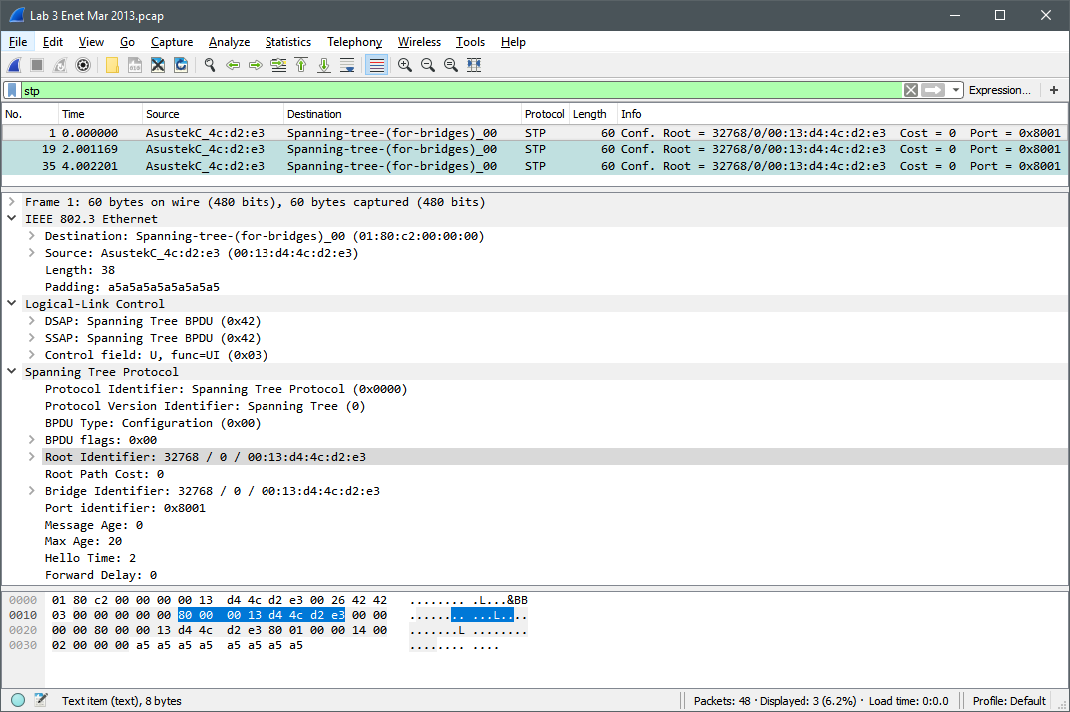
Wireshark Capture of BPDUs

Slide 16
Logic for Finding Root Ports and Designated Ports (1 of 2)
As shown on the previous two slides, each Bridge PDU (BPDU) includes:
The (presumed) root bridge ID
The distance in hops (path cost) from transmitting bridge to presumed root bridge (each individual LAN/link crossed counts as one hop)
The transmitting bridge’s ID (the source of the BPDU)
Every bridge will determine (from the multicast BPDUs that it receives) the shortest path to the root bridge, and its root port that leads to that path
If there is a tie for root port on a given bridge, the port whose upstream neighbor bridge has the lower bridge ID becomes root port. (“Upstream” means “toward the root bridge”.)
Then, all of the bridges connected to a given LAN compare their distance to the root
The bridge with the shortest distance becomes the designated bridge for that LAN, and the port on the designated bridge that connects to that LAN becomes the designated port for that LAN
If there’s a tie for designated bridge (on that LAN), the bridge with the numerically lowest bridge ID wins

Slide 17
Logic for Finding Root Ports and Designated Ports (2 of 2)
Any port that is not a root port or a designated port is disabled (blocked), since
it’s not part of the spanning tree
“Disabled” ports don’t transmit data frames, but they can transmit BPDU’s
After a designated port is selected for each LAN, it is possible that one or more
bridges will not have a designated port
When that happens, the root ports on those “orphaned” bridges are also disabled (since they won’t be used by any downstream nodes)
On each LAN, the designated bridge receives data frames on its designated port, and forwards them out its root port toward the root bridge
Any non-designated bridges on that LAN will only forward data frames out their root ports if they are the designated bridge on another LAN further (downstream) from the root
Note that if the forwarding table in any bridge indicates that a frame is to be filtered, it is filtered (as always)

Slide 18
Processing BPDUs
Compare the newly received BPDU to the previously archived “best” BPDU received on that port (if any). The new BPDU replaces the existing best BPDU if:
New BPDU contains a root bridge with a lower ID (new root bridge)
New BPDU contains a root with an equal ID that can be reached in fewer hops (same root bridge, but new shorter path)
New BPDU contains a root with the same ID and distance, but the source of the BPDU has a smaller ID (breaks tie between two different designated bridges that are the same number of hops from the root)
When a new BPDU is accepted, add 1 to the distance to the bridge (to add in the additional hop to the neighbor that sent you the BPDU)
If another bridge on the LAN becomes designated bridge, stop forwarding BPDUs out the port connected to that LAN
In case the root dies, all other bridges run a timer to watch for BPDUs from the root. They resume sending BPDUs if the root stops sending them, and a new root gets elected.

